Slide 1
Year 6 Residential Trip 5th to 7th June 2019
The Year 6 Team:
Mrs Hardgrave, Mrs Hayter and Mr Young

Slide 2
Kingswood Grosvenor Hall
A 50 acre indoor and outdoor education facility set in the grounds of a former manor house in Ashford, Kent.

Slide 3
What does Grosvenor Hall offer?

Slide 4
Information on Grosvenor Hall
Established for over 30 years
They run over1.2 million activity sessions each year
Visited by over 165,000 children a year
Educational programmes, challenging adventure activities and fun evening entertainment
Unforgettable adventure in a safe, controlled and nurturing environment
Exceptional standards of care, safety and guidance from friendly, highly qualified centre staff
Founding members of the British Activity Providers Association (BAPA) and have all the expected accreditations

Slide 5
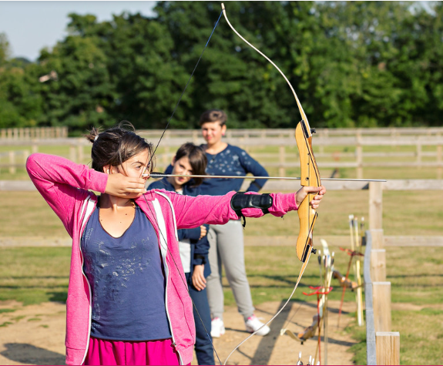
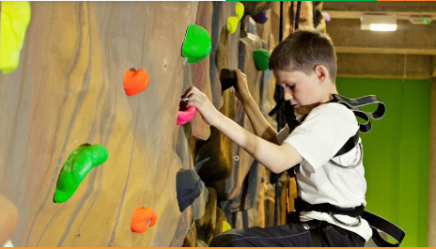
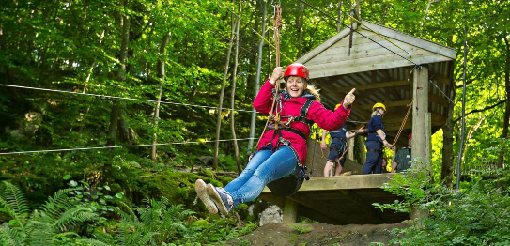
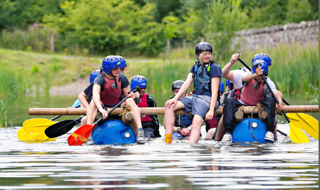
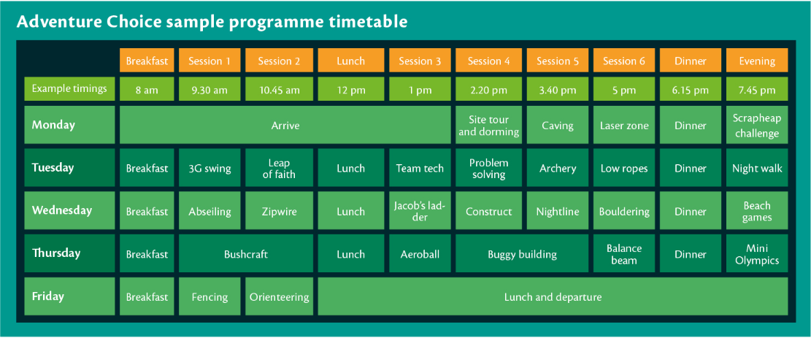
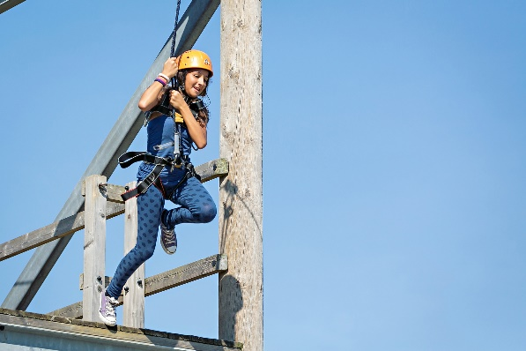
Some of the activities on offer

Slide 6
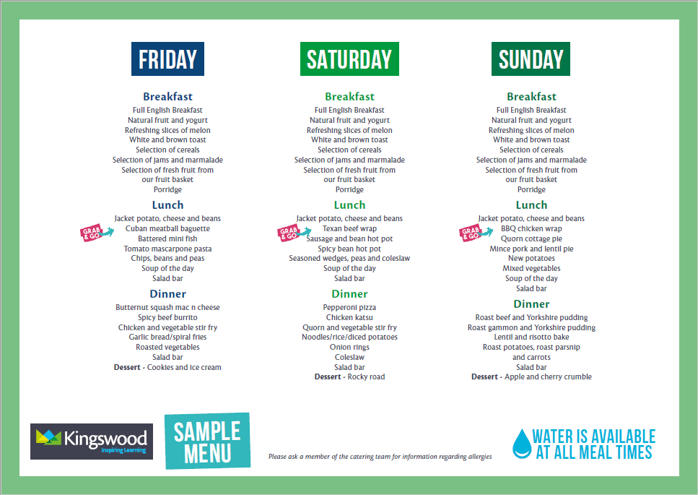
Sample menu

Slide 7
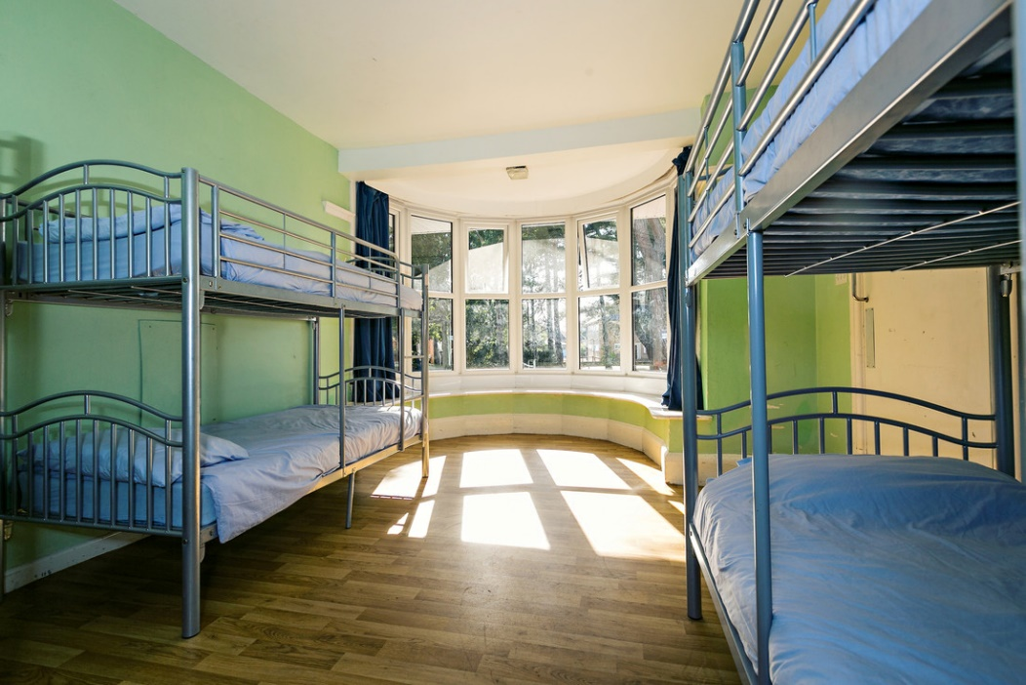
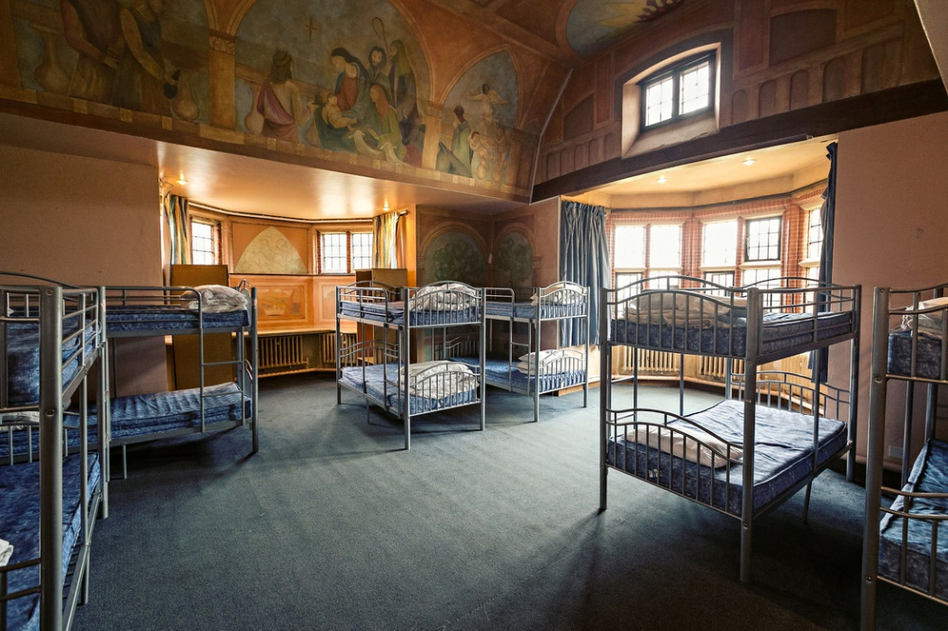
Accommodation
Grosvenor Hall offers dormitory style accommodation all of which have bathroom facilities and a daily housekeeping check. All of their accommodation is secure and comfortable and all bedding is provided. Pupils sleep in gender separated areas, with separate showers and toilet facilities. Teacher rooms are located close by to allow for plenty of supervision.

Slide 8
What does it cost?
£195 (payable in instalments)
Three days and two nights
All meals and refreshments
All activities
All evening activities
Return coach journey
Bedding is provided
There is a small gift shop. Your child may bring a maximum of £10 to spend.
PAYMENT DATE | AMOUNT DUE
30th October 2018 | £40 (non-refundable)
30th November 2018 | £31.00
30th December 2018 | £31.00
30th January 2019 | £31.00
27th February 2019 | £31.00
30th March 2019 | £31.00

Slide 9
Your child’s safety and enjoyment
We know how daunting it can be letting your child go on a residential visit, so we do everything we can to make it a safe and enjoyable experience
Grosvenor Hall policies and procedures are designed to make sure they adhere to the highest safety standards at all times:
Continual safety and first aid training for all staff
Regular checks on equipment before and after every activity session
Qualified First-Aider on centre 24/7
All staff are fully DBS checked
Grosvenor Hall create a warm, supportive environment for pupils so they quickly feel at home. All their activities are progressive, allowing students to join in at whatever level they are comfortable with
The best way to help children cope with being away from home is to keep them busy having fun

Slide 10
Code of Conduct

Slide 11
What will they need to take?
Clothing:
Nightwear
Underwear
Socks, including over ankle length
2 or more fleeces/sweatshirts
3 T-shirts
2 long sleeved T-shirts
3 pairs of old trousers (not jeans) 2 for activities, one for evening
2 pairs of trainers (1 for wet activities)
1 pair of slippers (for their room)
Waterproof jacket
Baseball cap/hat
Evening clothes
Wellington boots
Other Essentials:
Wash bag (soap, deodorant and toothbrush)
2 towels
Torch and batteries
Named Water bottle
Sunscreen
Pen and paper
Small bag/rucksack
Labelled plastic bag (dirty clothes)

Slide 12
What can they not take?
Do not bring: Mobile phones, expensive cameras, electronic games, iPods or MP3 players.
POPS will text parents to say they have arrived safely and with regular updates.

Slide 13
Do you have any questions?

